Slide 1
Professional & Business Services: an enabler
September 2018

Slide 2
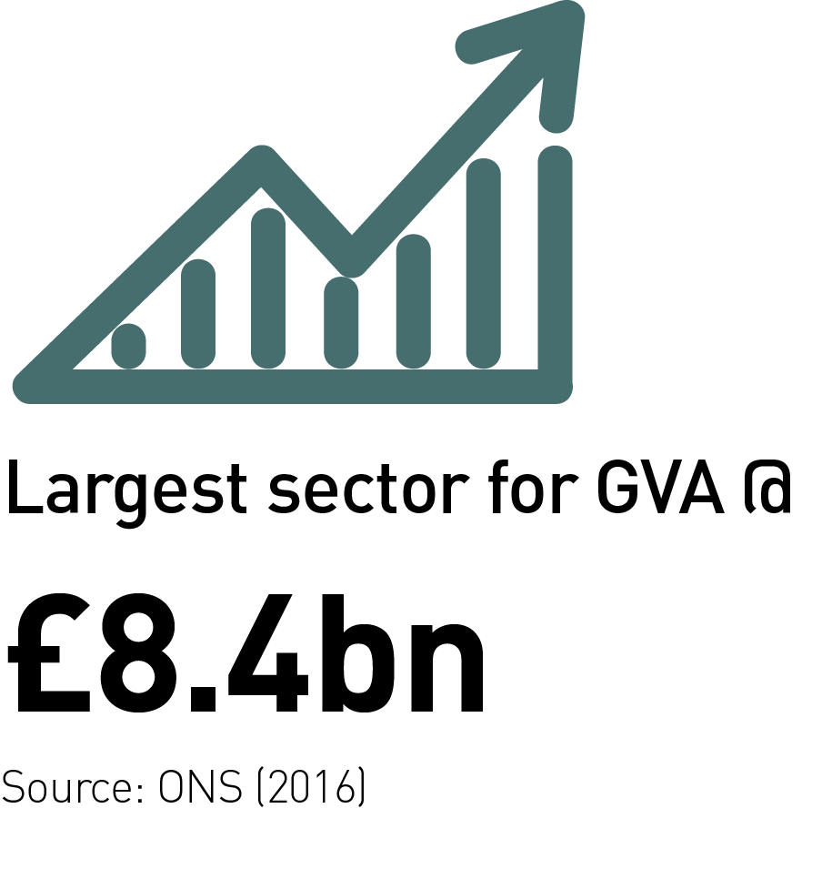
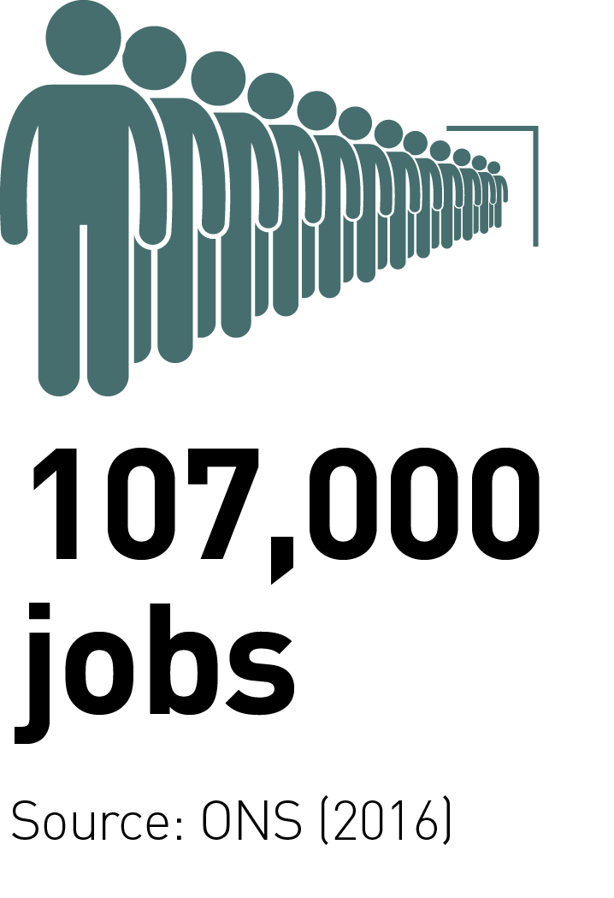
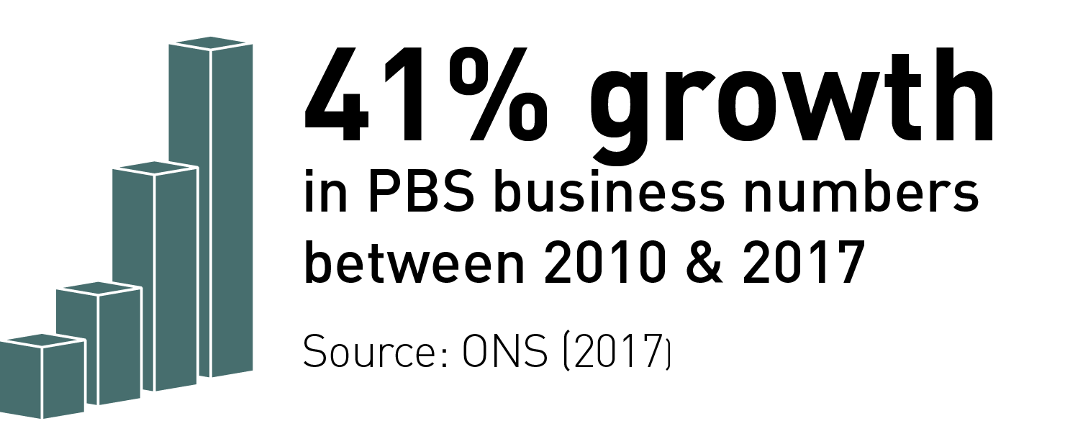

Size of PBS in LCR
Supports 107,000 jobs in 12,000 companies
£8.4bn GVA – largest sector in terms of GVA
Business numbers up by 41% between 2010-2017, compared to 23.5% across all sectors
PBS acts as the main enabler to the growth for every sector

Slide 3
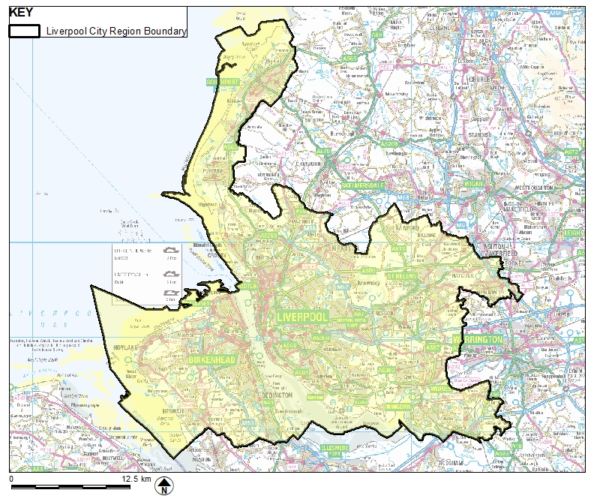
Liverpool City Region and beyond
Of those PBS firms selling products or services, 52% have their primary market outside the City Region. This outward facing perspective needs to continue.

Slide 4



PBS sector concentrations
Wealth management
Maritime sector is 4.5 times more concentrated than national average

Slide 5
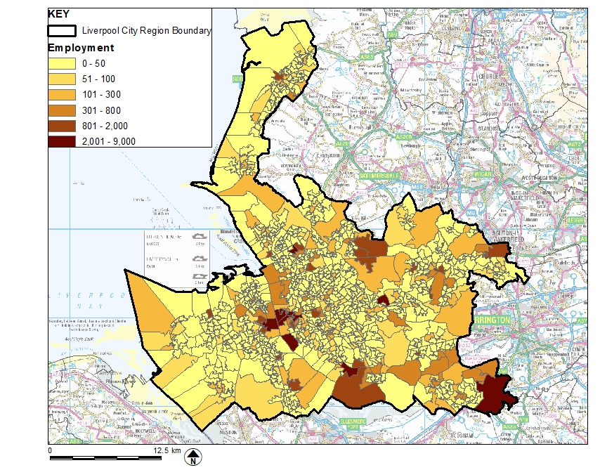
Distribution of PBS

Slide 6

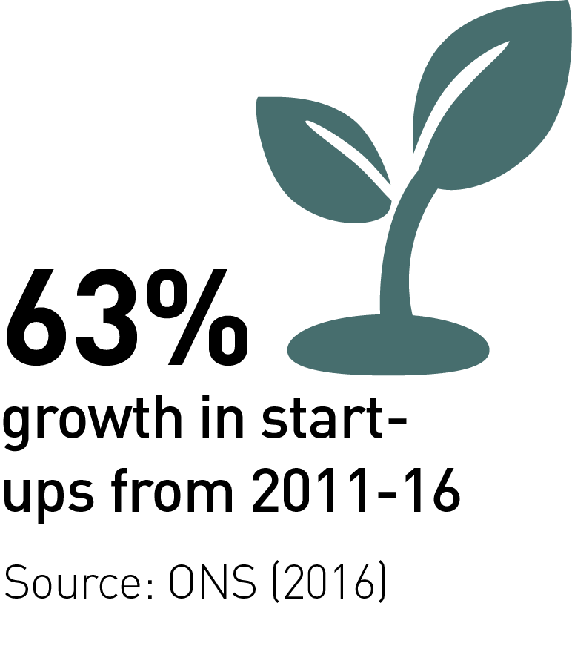

Future growth
PBS forecast to account for 36% of total increase in GVA in LCR 2016-2036
PBS jobs forecast 65% (20,000) of total employment change
Challenge is to achieve higher productivity jobs
Need more businesses created to catch up with NW and England density statistics
Need to improve 5-year survival rates to increase the number of long-term viable businesses

Slide 7
The City Region has strengths in other sectors, creating opportunities for PBS companies:
Digital: STFC Hartree Centre at SciTech Daresbury, houses the most powerful supercomputer in the UK dedicated to industrial R&D. Plans to link to the Hibernia fibre optic cable.
Science & innovation: infection; materials chemistry; and high performance & cognitive computing. Knowledge Quarter Liverpool in development including Sensor City
Advanced manufacturing: Jaguar Land Rover, Unilever, Pilkington, Ineos and Astra Zeneca, alongside Getrag, Johnson Controls and ABB. LCR4.0 initiative - helps SMEs to increase productivity and de-risk innovation.
Low carbon & energy: Around 1,400 low carbon businesses, designated as a Centre for Offshore Renewable Engineering (CORE Status) by the government. Plans to create a tidal barrage. World’s largest offshore windfarm.

Slide 8
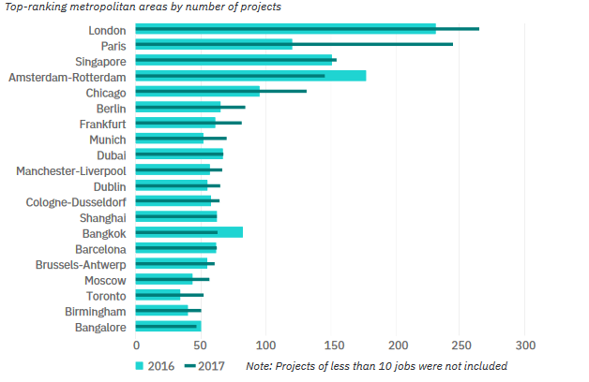
FDI - 2018 Global Location Trends
IBM Institute for Business Value
Notes:
From 2016 to 2017 Liverpool and Manchester secured 68 major investment projects, creating more than 7,000 jobs.

Slide 9
LCR employer skills survey 2017
Below UK in terms of higher level PBS qualifications across all age bands
62% report shortages in technical skills specific to sector/role (survey average 48%)
Shortages in PBS in professional occupations (32%) and technical & associate professional occupations (31%) vs. survey-wide 18% & 17%
Most common skills gaps were specialist skills or knowledge (52% vs. survey average 47%), basic communication skills and knowledge of how the organisation works (both 35% vs. survey average 32% & 26%)
21% PBS businesses employ apprentices, below survey average 26%
Notes:
Supporting training and development in the PBS workforce is important to improve skill levels of existing City Region residents and address skills shortages within the sector.

Slide 10
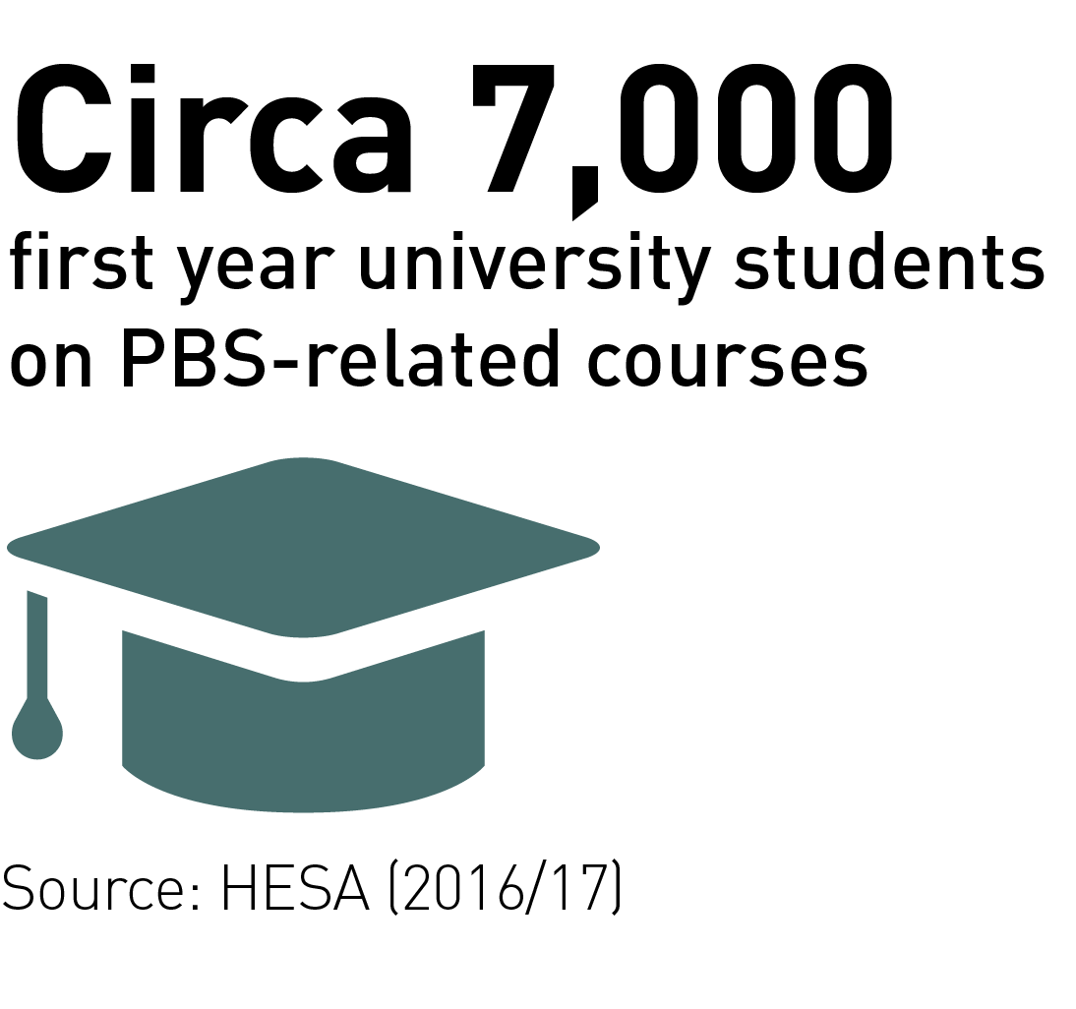
Developing the talent pool
Students: c7,000 first year PBS
33-55% PBS graduate retention
22% of PBS businesses offered placements in the last year (24% skills survey 2017 average) but 41% of those who did not would consider doing so (34% survey average)
Better support and co-ordination of employer encounters and careers guidance at school is needed

Slide 11
Business density
Need more business start-ups and density across all sectors
In line with regional and national trends for 1-year survival
5-year survival remains an issue when considered against the national picture

Slide 12

Strategic priorities
Promoting the sector: Developing collateral to promote locally, nationally and internationally as well as cross-sector.
Skills: Supporting schools to achieve the Gatsby benchmarks and developing closer public/private sector relationships.
Access to finance & business base: Establishing an active investor network and creating a digital tech/life sciences fund to boost the sector.
Inward investment: Developing a target list of sector relevant footloose companies and exploring the role of north-shoring in growing the target sectors.
Commercial space: Boosting the supply of Grade A office space.

Slide 13
Measures of success
Improved careers awareness and aspiration among school pupils
Talent retention
Improved local skills and qualifications
New jobs, more businesses
Improved long-term business survival and increased GVA
The combined effort of our enterprising and supportive City Region stakeholders – each one of us has a role to play
City Region wide collaboration
Notes:
To successfully address the priorities and achieve optimum results we need
Liverpool City Region LEP; the PBS Board; Local Growth Hub; Professional Liverpool; Liverpool Commercial BID; Liverpool Law Society; universities; Chambers of Commerce; colleges; all six constituent councils of the City Region; and schools.

Slide 14
Thank you for your time
Full LCR PBS baseline review is available at https://www.liverpoollep.org/

